Slide 1


TEAMO7
ITERATION 01
BROWNIE
GITHUB LINK
A PYTHON-BASED FRAMEWORK
2023
TEAM MEMBERS:
SAI SRI LAKSHMI NANNAPANENI-1002077755
AMAN MITTAL-1001979035
RUKESH SAI KASTURI-1002049844
PAVAN SAI AKULA-1002082165
(01)

Slide 2




INSTALLATION & COMPLETE SET UP
Python
Installation
Debugging & Testing Suite
Done with setting up the environment and started working on the analysis of bugs.
Created a Project
Smart Contract Compilation
(02)

Slide 3

Limited Input Parsing
Lack of Detailed Error Messages
BYTE ARRAYS NOT PARSED ELEGANTLY (#1568)
01
03
struggles with certain input formats, especially hexadecimal, despite handling decimals well
error messages aren't descriptive, potentially due to insufficient logging or error-handling mechanisms
Diagnosis and Root Cause Analysis
ABI Decoding
Testing Limitations
02
04
Incorrect input passing in Brownie might lead to failures or inaccuracies during ABI decoding in Solidity
The current tests mainly cover standard scenarios, missing out on potential edge cases or unexpected inputs
(03)

Slide 4
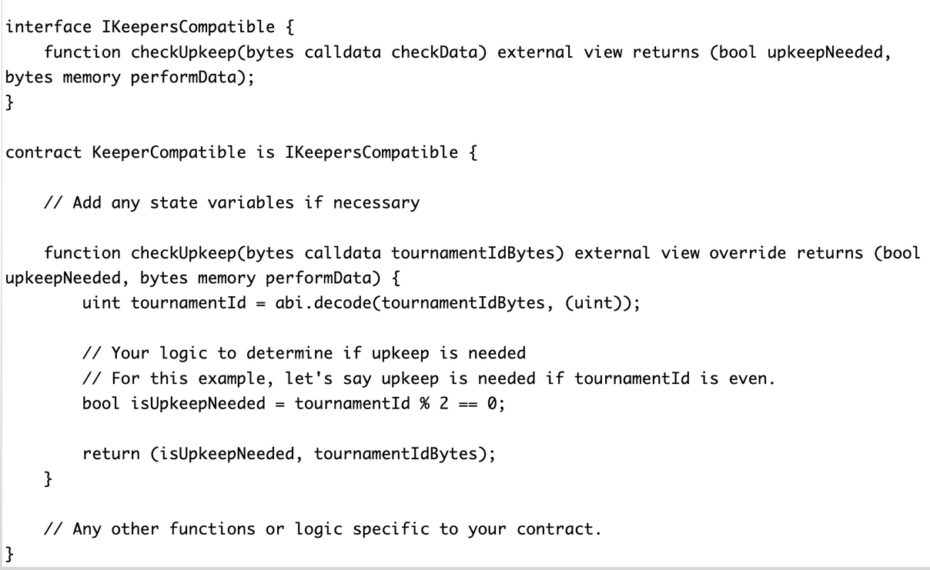

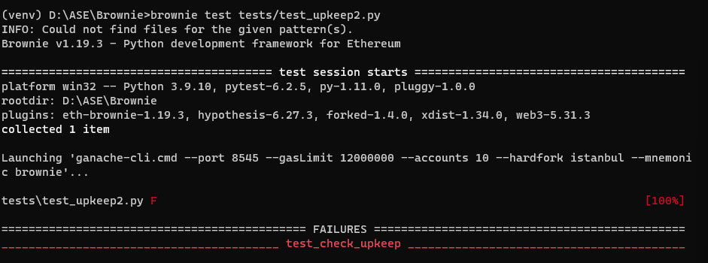

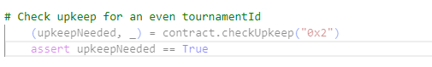
ERRORS AND USE CASES
01
should be capable of testing various input formats, such as hexadecimal, not just decimal
(04)

Slide 5
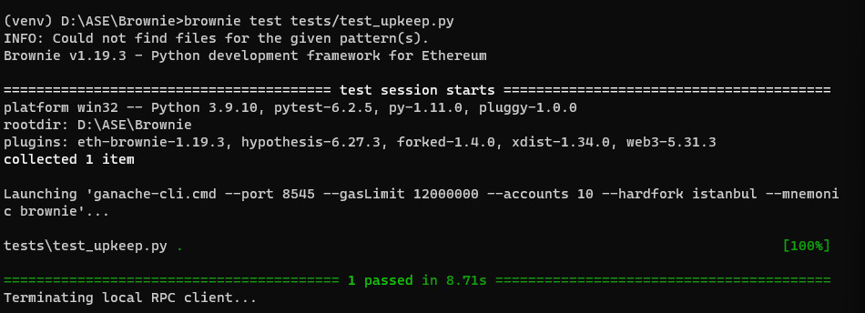
ERRORS AND USE CASES
02
should be capable of testing various input formats, such as hexadecimal, not just decimal
(05)

Slide 6
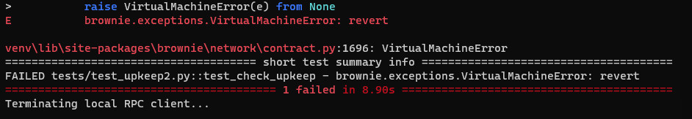
ERRORS AND USE CASES
03
It’s hard to debug without proper logs, the function should log relevant data
(06)

Slide 7


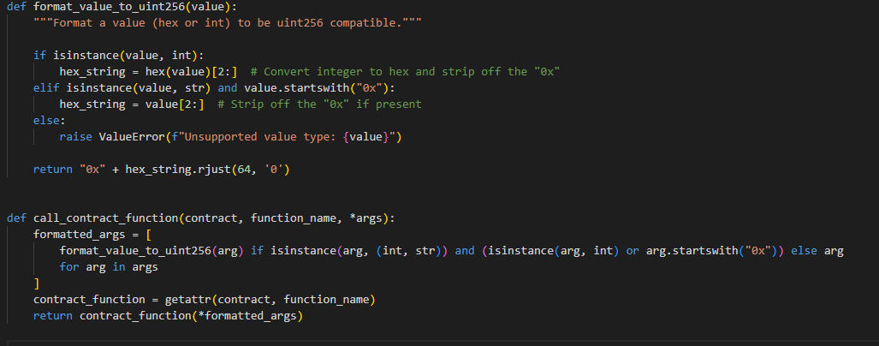
HOW WE SOLVED
1
Creating the package
Created a Python package that provides additional functionality when imported alongside Brownie
(07)

Slide 8
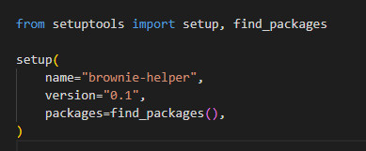
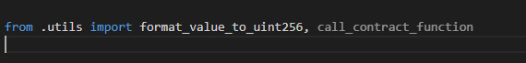
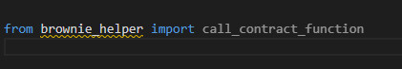
2
HOW WE SOLVED
SETTING UP THE PACKAGE
3
ADD IMPORTS
4
Setting up the package and installing package in editable mode so that it can be imported and used by anyone.
USE THIS PACKAGE
(08)

Slide 9

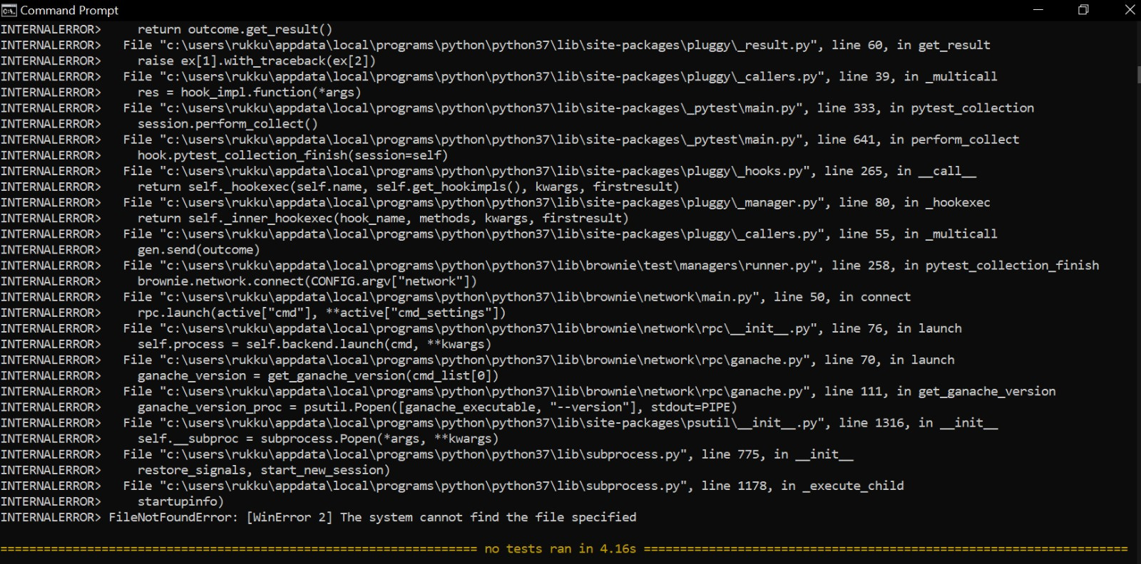
COMMON ERROR FACED WHILE WORKING ON THE BUGS
we refferred brownie github and none of them worked for me
#1148 given a solution that didnt worked
#1259 again was not helpful
#1306 it was for different issue where ganache was not installed
(09)

Slide 10



ITERATION 02 FOCUS:
ERROR WITH VYPER TESTS #1653
Diagnosis
The team prioritized diagnosing the root cause of the errors encountered during Vyper tests
our primary objective is to diagnose and address Bug #1653, which involves errors encountered during Vyper tests
Root Cause Analysis
Through this we pinpoint-ed the exact source of the problem, ensuring that the subsequent solution is precise and effective
(10)

Slide 11



Temporary Workarounds
Temporary workarounds or patches might be provided to ensure developers can continue testing
PROGRESS
As a result of Bug #1653 being fixed, the Brownie framework will be more reliable and user-friendly, which will eventually be advantageous to both developers and the larger community
Collaboration
Engaged with the Vyper community and developers to gather insights and potential solutions
(11)

Slide 12

THANK YOU
FOR WATCHING
(12)

